Slide 1
Git – The stupid content tracker

Slide 2
Agenda
Overview
Structure
Branching & Merging
Use cases

Slide 3
History
BitKeeper ceases to be open source
Linus looks for alternatives
  Emphasis on speed, volume, patches
  Nothing suitable, so develops his own
Timeline:
  3/4/05 – start
  7/4/05 – self hosting
  18/4/05 – merging
  16/6/05 – kernel 2.6.12 managed by git

Slide 4
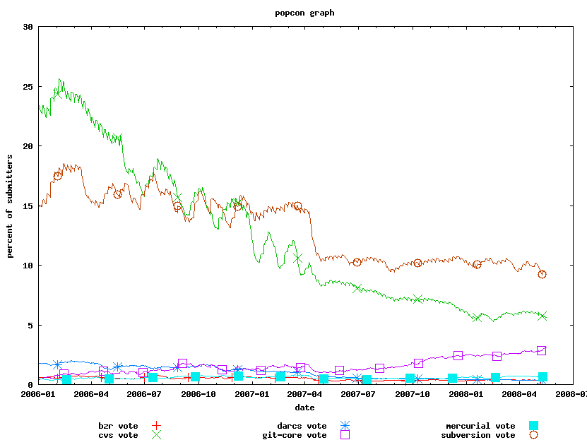
Usage Trends (Debian)‏

Slide 5
Projects Using
Linux Kernel - ~25,000 files
x.org
wine
rails (github)‏
mozilla

Slide 6
Basic Usage
git init
{edit files}
git add <files>
git commit -m <msg>
goto 2
All commits are local
Remote:
  git clone <remote repo>
  git pull & push – sync with remote repo (branches)

Slide 7
Goals
Distributed
Handle large trees
Fast
  Git checkout faster than cp -a
Support patches
Branching
Simple
Cryptographic authentication of history
Notes:
Kernel source treeinitial commit was 220MB
git-checkout is faster than 'cp -a' if the repository is packed, since there's only one file to read from (http://www.advogato.org/person/apenwarr/diary/369.html)‏

Slide 8
DVCS
No central repository
  Or, anybody can be a central repository
Clean history
  Private branches for individual or small team work
  Frequent commits
No need for connectivity

Slide 9
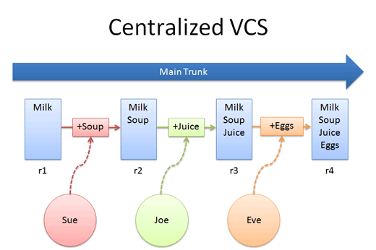
Centralized

Slide 10
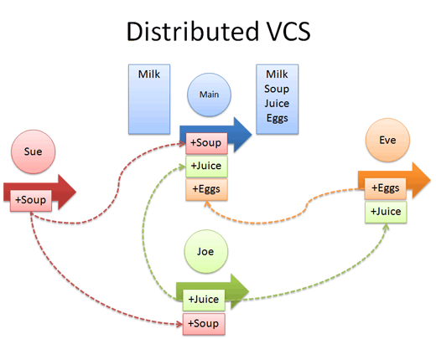
Distributed

Slide 11
Philosophy
Git tracks content, not files
  If a file moved, but it contents did not change, then it is the same
  Content never changes (new content)‏
No 'metadata' tracking (renames)‏
  Result: Patching == manual editing
Unix-like: many small commands
  ls-files, cat, archive, grep, fsck...gc
  Plumbing vs. Porcelain

Slide 12
Structure
Object database holds:
  Blobs
  Trees
  Commits
  Tags
Every object is referenced by its SHA1 hash

Slide 13

Blob
Any concrete file.
Binary or text (or symlink)‏
Every commit creates a new Blob for every file that changed
  But blobs can be packed using git-repack
Hello World

Slide 14



Tree
Representation of a directory
References blobs or other trees
  sha1, name and metadata (mode)‏
Reference is via SHA1 id
file1
subdir1

Slide 15

Commit
A link in a history of tree changes
References the commits it came from and a tree it represents
Complete authenticity
Parent(s)‏
Root Tree

Slide 16








All Together

Slide 17

Tags
Names a certain commit
  But can also tag files or trees
Contains description and information on the person that tagged
Can be signed (and by referencing the commit's sha1, that is also signed)‏
object
tagger: Ittay
<description>

Slide 18
Objects “Database”
Directory structure under .git/objects
Objects stored as compressed files whose name is the object's SHA1
Objects can be 'packed' into a single file with delta compression

Slide 19
Demo?

Slide 20
Cache/Index/Staging
A file that tracks objects that will be committed
A mediator between database and working tree
  Checkout and commit go through it
Used for marking merge conflicts

Slide 21
Branches
A branch is just a file with a reference to a commit id
Current branch is what .git/HEAD points to

Slide 22
Merging
Find common commit ancestor
Several strategies
  resolve
  recursive – merges multiple common ancestors
  octopus – more than two branches
  ours – just mark as merged
Unresolved merges are kept as 'staged' in the index

Slide 23
Merging - Contd.
git-rerere - Reuse recorded resolution of conflicted merges
Rebase – keep history (&patches) clean
  rebase --interactive

Slide 24
Disadvantages
Too much hacking can mean a broken trunk (esp. git add –interactive)‏
no real distinction for modules or directories. git-commit allways starts out from the root directory.
  git submodules
Renames are not tracked explicitly
  use '–follow -l50000' in diff, log
  git config –global diff.renamelimit 0
  ~3000 files (28M), ~70 commits: 1:30m

Slide 25
Gotchas
changes not committed without explicit add
if you add a change, then change some more, only the older changes get committed
git diff shows difference between index and working dir, not HEAD and working dir
  git diff HEAD

Slide 26
Commit Revs
SHA1
Symbolic name
<ref>@{time}
<ref>^[{n}]
<ref>~[{n}]
  equivalent to <ref>^^^^ n times
many more...

Slide 27
Use Cases
Things you can't (or are harder to) do in centralized vcs
Non trivial found by thinking of a use case and finding a solution somewhere

Slide 28
External Project
You want to make changes to a centralized project
  No commit privileges
  Or, be able to manipulate local commits
git svn, git cvs
svn/cvs as remote repository
local branch under git
Git for SVN users: http://git.or.cz/course/svn.html

Slide 29
Cancel a commit
From latest to some point
  git reset –hard <where>
  makes HEAD point to <where>
  commit still there, if you know its SHA1
  use gc to collect, fsck to find
Some commit in the past
  git revert <commit>

Slide 30
Fix latest commit
fix the files
git commit --amend

Slide 31
Fix a commit history
Commit a fix, commit another feature, fixed the fix
rebase –interactive HEAD~3
  pick 0885540 Implemented A
  pick 320b115 Implemented B
  pick b9a8405 Fixed A
Reorder
  pick 0885540 Implemented A
  squash b9a8405 Fixed A
  pick 320b115 Implemented B
A
B
A'

Slide 32
Suspend work for a fix
Work on feature A, want to commit a fix to something else
git-stash save
commit a fix
git-stash apply

Slide 33
Moving work to a branch
You work on master, make some commits, and then want to move that work to its own branch
  git checkout -b new
    Create (and switch to) the "new" branch.
  git branch -f master HEAD^^^
    Forcibly move master back three versions.

Slide 34
Find a bug
git bisect start
git bisect bad <ref>
git bisect good <ref>
git bisect good/bad...
git bisect reset

Slide 35
Cherry Picking
git cherry-pick <commit>
git cherry – show what commits were merged

Slide 36
Partial commit
You made several unrelated changes to the same file
git-add -p
  Opens up an interactive session
Choose which hunk of each patch to add to the index

Slide 37
Split commit
You committed two unrelated changes in one commit
git rebase –interactive
mark the commit as 'edit'
git reset HEAD^
  undo that commit (working dir untouched)‏
git add -p
  add part of the commit
  Continue as needed
git rebase --continue

Slide 38
Filter branch
git filter-branch allows rewriting of an entire branch
apply commands to all commits
git filter-branch --index-filter 'git update-index --remove filename' HEAD

Slide 39
Find stuff
Find a file containing a string
  git grep [--cached] [tree] -- [<path>..]
Find a change
  git log --since="June 5, 2005" --grep="find this" --author="bob@domain.com" --pretty=oneline some-branch -- crypto/*.c

Slide 40
Annotating
Can track code reordering with -M
Can track code move between files with -C

Slide 41
Conclusions

